Slide 1

Topic: Substitution
EQ: How do we substitue into a formula?
Mrs. McLeod

Slide 2
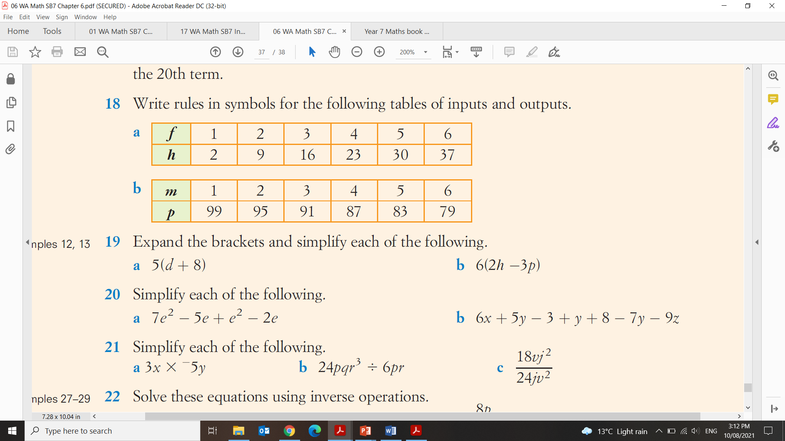
Topic: Substitution
EQ: How do we substitute into a formula?
Warm Up

Slide 3
24
7
30
Topic:
Date
Substitution
EQ:
How do we substitute into a formula?
What is substitution?
We can think of variables as letters that are “holding the place” for a number
With substitution we can evaluate the expression and work out the answer
How do we substitute?
Evaluate 2a+3 if a=10
2a+3
2×10+3
Step 1: We replace the variable (letter) with the number
Step 2: We follow BIMDAS steps to get a solution
2×10+3
Multiplication first
= 23
replaced
20 + 3
Ex 1.
Evaluate 5 + m if m=8
5 + 8 =
13
replaced
Ex 2.
Evaluate 3a – 3 if a=5
3×5 - 3 =
15 – 3 =
12

Slide 4

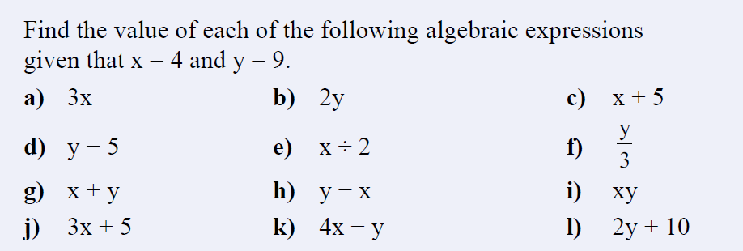
I Do We Do You Do

Slide 5
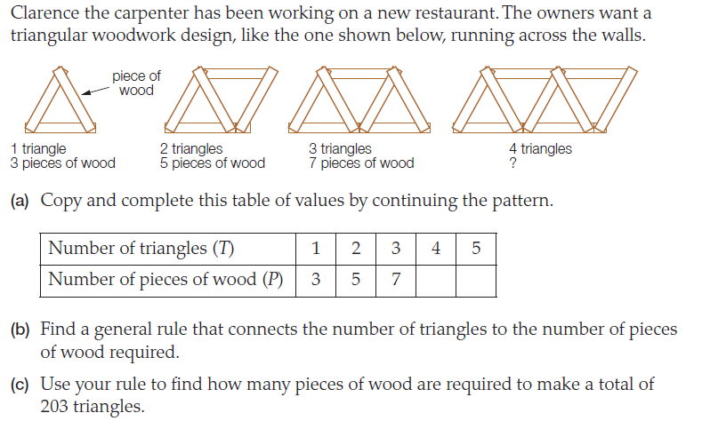

Slide 6

24
7
30
Topic:
Date
Substitution
EQ:
How do we substitute into a formula?
Quick Write – 60 seconds
When can we use this in real life?
Calculating costs and wages is the most common everyday uses
Calculating time it takes to arrive somewhere based on speed, or calculating the speed you need to travel to get somewhere by a certain amount of time
Paying off loans or paying rent
Comparing prices of items of different amounts to calculate total cost to make a recipe

Slide 7

Hannah has two different job offers and she is trying to decide which one will get her the most money each week. Hannah is available to work 8 hours every Monday – Friday.
Job A: earns $20 p/h and a daily bonus of $10
Job B: earns $22 p/h but she has no daily bonus
Quickly take a guess which one do you think will be the best option for Hannah?
Formula: $\left(e×8+b\right)×5=total earnings for the week$
Job A : e = _______ b = ________
Job B : e = _______ b = ________
Job A has now told Hannah she will instead earn $21 per hour. Should she take that job now?
Notes:
Take a poll on the board for the guesses and turn into fractions and percentages of the class

